Slide 1
Finding Best Locations for Restaurant in The Hague City of South Holland Solomon Edwin Musa 21 April 2019

Slide 2
Introduction
The Hague City in the Netherlands (South Holland) is the target city of this project.
The project is about assessing the best locations for a restaurant within the eight urban districts (Boroughs) comprising the Hague City in South Holland.

Slide 3
Background
A group of immigrants arrived from Asia and South America to seek asylum in the Netherlands and have been given a stay within the Hague City
They prefer to start and engage in restaurant business, which they claimed to be their profession.

Slide 4
The Problem
However, the Hague City is already a scene of diverse type of restaurants everywhere, and with restrictive regulations on business locations, there is need to guide immigrants who want to establish restaurant businesses
The City Council contracted me as a Data Scientist and Analyst to investigate the best possible locations for restaurants, and to provide them recommendations on possible locations in a presentation
Results will used to determine whether the council will provide financial assistance to these immigrants in order to start their food restaurant businesses of interest.

Slide 5
Data Sources
Districts/Boroughs, Neighborhoods, and Population data was manually extracted from this link: https://www.angloinfo.com/blogs/netherlands/south-holland/expatinfo-holland/city-districts-the-hague/ . There was no need for web scraping because data was readily available.
Latitude and longitude values for boroughs were also manually acquired from this link: https://www.distancesfrom.com/Den-Haag-latitude-longitude-Den-Haag-latitude-Den-Haag-longitude/LatLongHistory/14049.aspx?IsHistory=1&LocationID=14049 The reason for manual extraction is due to small size of data available free access
Proprietary Web sites include the following links as examples: https://www.postcode.nl/services/adresdata/api ; https://api.postcode.eu/nl/v1/addresses/latlon/

Slide 6
Procedure for Data Analysis
The procedure for segmenting and clustering neighborhoods in Machine Learning was used
The steps are here itemized, and which were followed for each of the three districts or boroughs investigated
The research was limited to this three because Hague Centrum represents a district or borough as a seat of government with a population of 103,279, the Escamp district with a population of 122,825, and Schevenngen district with a population of 55,976 but having 8 neighborhoods compared to other districts
Additionally, due consideration was given also to resource use optimization as well as the limitation posed by foursquare on the calls per day for venues.

Slide 7
The Procedures
After importing all necessary libraries for analysis:
After importing all necessary libraries for analysis
The Hague City dataframe (thcty_data) was created manually with data obtained from the sources mentioned above;
Hague Centrum data (hgcentrum_data) was created by slicing the Hague City dataframe;
Used geopy to get the Hague Centrum coordinates but creating map with folium failed;
Used Foursquare API procedures, then explored the first neighborhood of Hague Centrum, and getting its latitude and longitude values;
To get the top 10 venues in this neighborhood and within a radius of 500m and a limit of 100, a url was defined and used with the GET requests to retrieve venues results from foursquare;
A get_category_type function from foursquare was used that extracts the categories of each venue
The resulting json file was cleaned and structured into a Pandas dataframe and to get nearby_venues;
To explore all neighborhoods in Hague Centrum, a function to repeat the procedure applied to exploring the first neighborhood was used that returned the nearby_venues;

Slide 8
Procedures Continue
Procedures continue:
A code to run the function above (in 8) was used on each neighborbood and then a new dataframe hgcentrum_venues, and how many venues returned per neighborhood a groupby method on neighborhood with count function was used, followed by getting unique categories returned by all venues;
To analyze each neighborhood and prepare for clustering later, a onehot encoding was applied to create hgcentrum_onehot dataframe;
The onehot dataframe was then used to group rows by neighborhood and by taking the mean of the frequency of occurrence of each category, defined as hgcentrum_grouped;
Each neighborhood was printed along with the top 5 most common venues;
The above was put into a dataframe by first using a function to sort the venues in descending order, then a new dataframe hgcentrum_venues_sorted was created;
The neighborhoods were then clustered by running k-means into a number of clusters, 2, 4, or 5 depending on the number of venues earlier returned for each neighborbood;
Then a new dataframe including the clusters and the top 10 venues for each neighborbood hgcentrum_merged was created, and again, attempt to visualize a map with folium failed;

Slide 9
Procedures Continue
Procedure continue:
The clusters were examined, but in all cases only the first cluster returned a result, probably due to low number of venues returned by each neighborhoods.
Therefore, the most important results returned and presented are the hgcentrum_venues_sorted, hgcentrum_merged, and hgcentrum_centrum cluster 1 for each districtt or borough investigated.

Slide 10
Data Cleaning
Since almost all the data required for this research was free and readily available, and the fact that the size is small, the dataframe was created manually for convenience and named hgcty_data.
Data cleaning was therefore not an issue in this case, except for the foursquare venues data acquired for the first and the rest of the neighborhoods for each of the three districts investigated
To clean the foursquare data returned, firstly, the get_category-type function was used, and followed by the normal procedure for cleaning the returned json file and to structure it into a pandas dataframe, with respect to the procedures for segmenting and clustering neighborhoods, and with reference to the procedures itemized above.

Slide 11
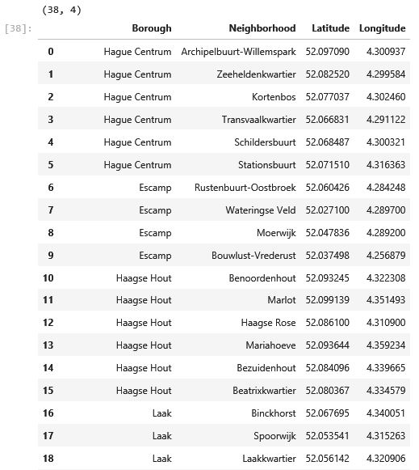
Results
The Hague City Data thcty_data

Slide 12
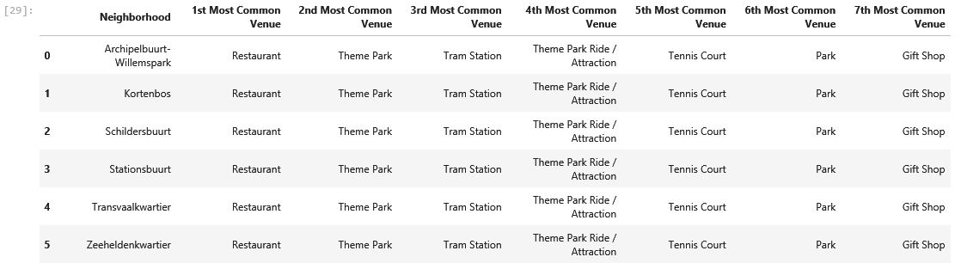
Hague Centrum Results
Table 2: hgcentrum_venues_sorted

Slide 13
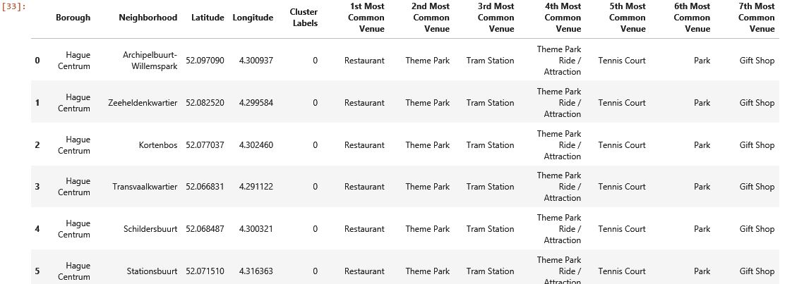
Hague Centrum Results Continue
Table 3: hgcentrum_merged

Slide 14
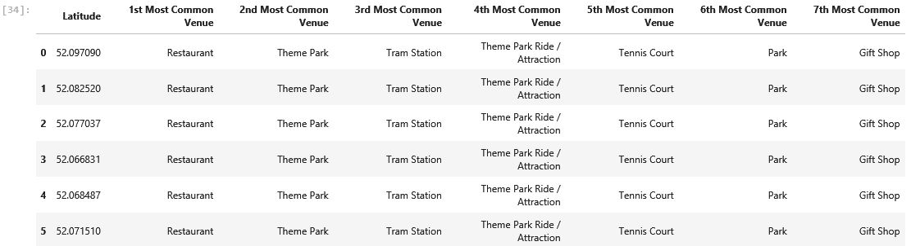
Hague Centrum Results Continue
Table 4: hgcentrum_Cluster 1

Slide 15
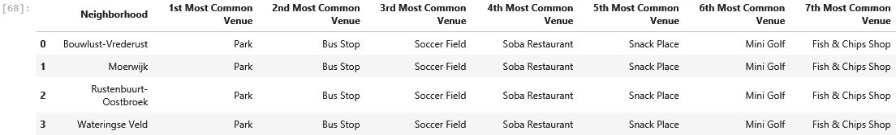
Escamp Results
Table 5: escamp_venues_sorted

Slide 16
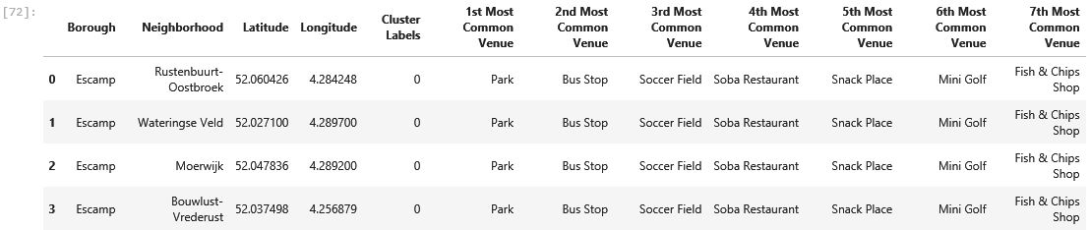
Escamp Results Continue
Table 6: escamp_merged

Slide 17
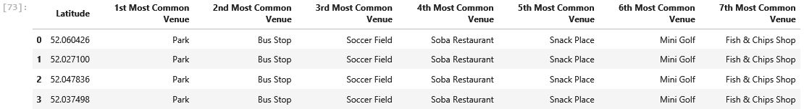
Escamp Results Continue
Table 7: escamp_cluster 1

Slide 18
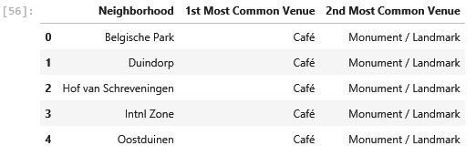
Scheveningen Results
Table 8: schev_venues_sorted

Slide 19
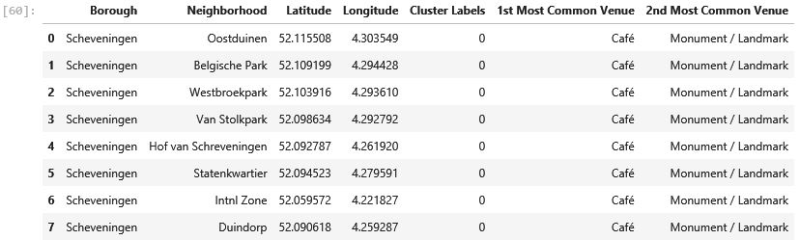
Scheveningen Results Cotinue
Table 9: schev_merged

Slide 20
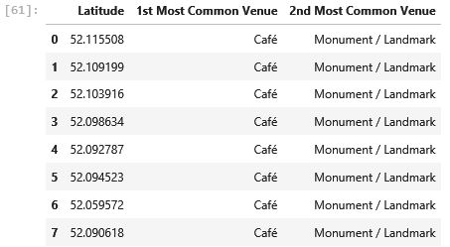
Scheveningen Results Continue
Table 10: schev_cluster 1

Slide 21
Discussions and Conclusion
Table: 2 hgcentrum shows the first most common venues in the Hague Centrum and its 6 neighborhoods are restaurants, second are theme parks providing different types of amusements and attractions for adults, teenagers, and children, third is tram stations meaning a transport hub, fourth is another type of theme parks for riding attractions, fifth are tennis courts, sixth are normal nature parks, and seventh are gift shops.
In summary a lot of humans are attracted to this district, especially in summer when activities peak. These could likely be the reason for attracting the establishment of restaurant businesses. This is evident in all results presented for Hague Centrum, Tables 3 and 4.

Slide 22
Discussions and Conclusion Continue
Tables: 5 – 7 are results for the Esamp borough with 4 neighborhoods. The first most common venues are normal nature parks, second are bus stops, third are soccer fields, fourth are specific private restaurants named Soba, fifth are snack places, sixth are mini Golf fields, and seventh are fish chips shops.
It indicates different location for mixed type of foods and restaurant businesses. This could be as a result of the type of venues around and quite different from the theme parks in the Hague Centrum which provide a big center of amusements and attractions. Here could be rated second possible location for mixed type of restaurant or food businesses.

Slide 23
Discussions and Conclusion Continue
Tables: 8 – 10 are results for Scheveningen district or borough with the highest number of 8 neighborhoods, compared to the rest of the other districts or boroughs making up the Hague City.
The results show the first most common venues to be cafes, followed by Monuments or Landmarks. This is a totally different location and mostly cafes are found and not much venues of attractions compared to other districts or boroughs. That does not mean restaurants may not be present or cannot be established if law or government regulations does not disallow that.

Slide 24
Future Directions
Only three districts or boroughs were investigated with Hague Centrum showing the best locations for a restaurant business, followed by Escamp district or borough, and lastly Schveningen.
The other districts or boroughs, five in total, not investigated by this research there could be possible additional locations for restaurant businesses and could even surpass Hague Centrum. One never can tell without investigating.

Slide 25
Future Directions Continue
The next steps to further improve on this research are:
To investigate whether any strong relationship exists between restaurants establishment and the presence of theme parks as well as other centers of human activities around and which types, through regression and predictive models using Machine Learning techniques.
Other districts could add to the understanding of possible suitable locations if further investigation is done on the remaining districts or boroughs not investigated by this research.
It will be good also to investigate what regulations or policies, if any, are in place to guide the location of restaurant businesses, and perhaps for other human activities in each district or borough.

